Slide 1

Welcome to BookMyMandap: Your Dream Venue Awaits
Discover the hassle-free way to find and book Mandaps, designed to connect users and providers effortlessly. Our platform creates seamless event experiences by simplifying the entire venue booking journey.

Slide 2

The Problem: Traditional Venue Booking is a Headache
Time-Consuming Searches
Lack of Transparency
Pricing and venue availability remain unclear, frustrating users and providers alike.
Users spend over 40 hours navigating through scattered information, making endless phone calls to find a suitable Mandap.
Disorganized Process
Poor communication and outdated listings result in inefficient booking experiences.

Slide 3
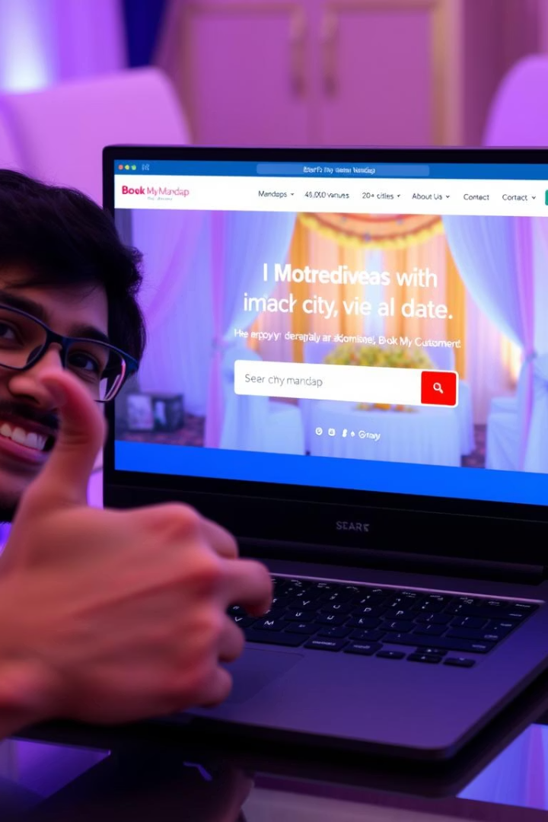
Our Solution: BookMyMandap - Simplifying Venue Booking
Unified Platform
Streamlined Experience
Connecting users directly with Mandap providers on a single easy-to-use platform.
Efficient search, booking, and management tools reduce time and effort.
Transparent & Organized
Clear pricing, availability, and secure transactions ensure trust and convenience.

Slide 4



Technology Stack Behind BookMyMandap
Frontend Technologies
React.js for dynamic UI
Sonner for elegant notifications
Backend & Database
React Big Calendar for scheduling
Node.js runtime server-side
Recharts for visual data
Express.js API framework
Moment.js for date handling
Bcrypt for password security
Ant Design UI components
Nodemon for live reloads
Zustand for state management
JWT for secure authentication
Typewriter-effect for animations
MongoDB for NoSQL data storage
React Router for navigation
Tailwind CSS for fast styling

Slide 5
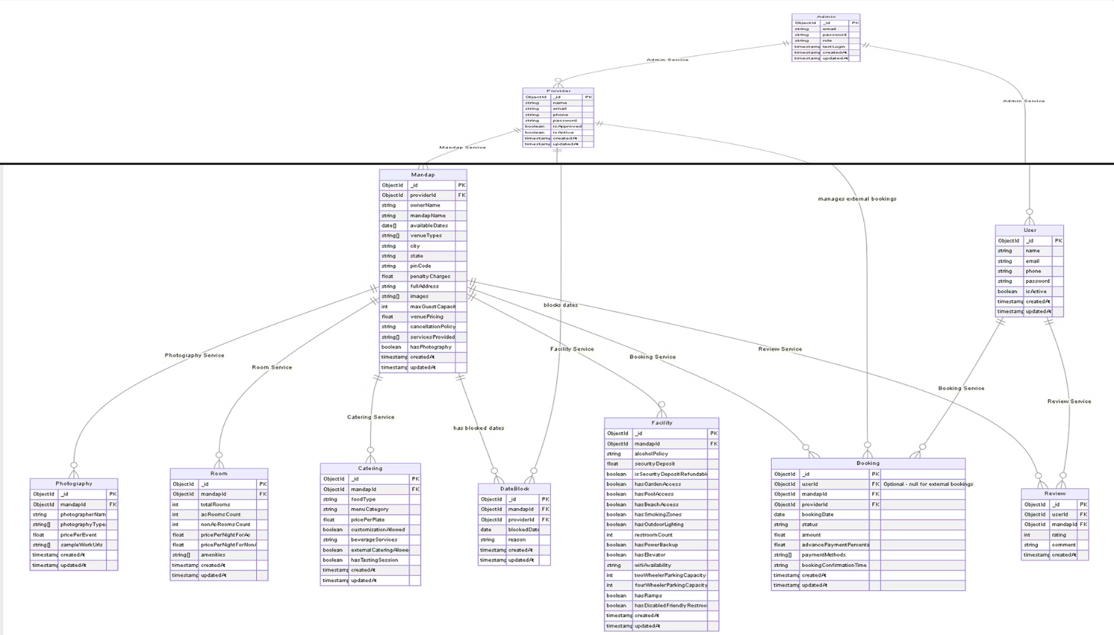

Slide 6
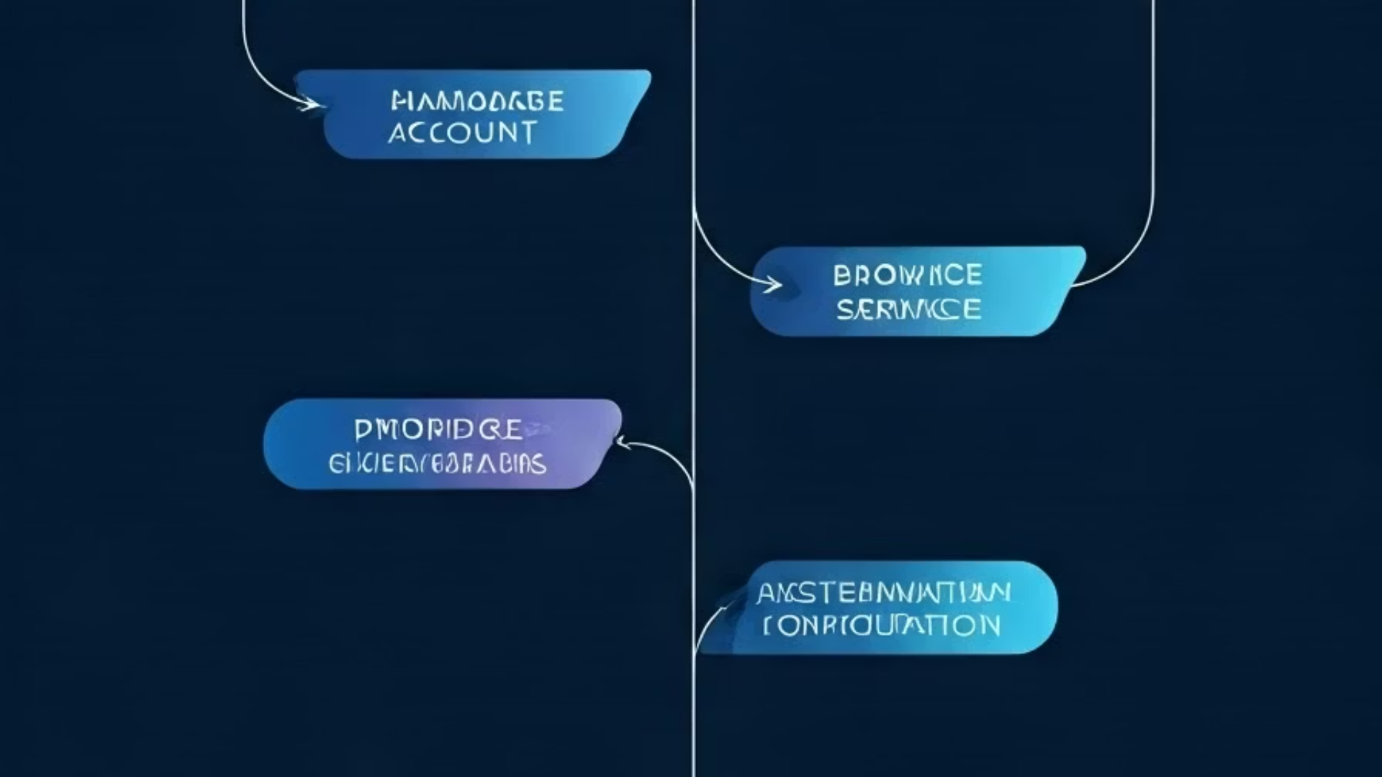
BookMyMandap’s Use Case Diagrams
Explore the core actors driving our platform: Users, Providers, and Admins.

Slide 7
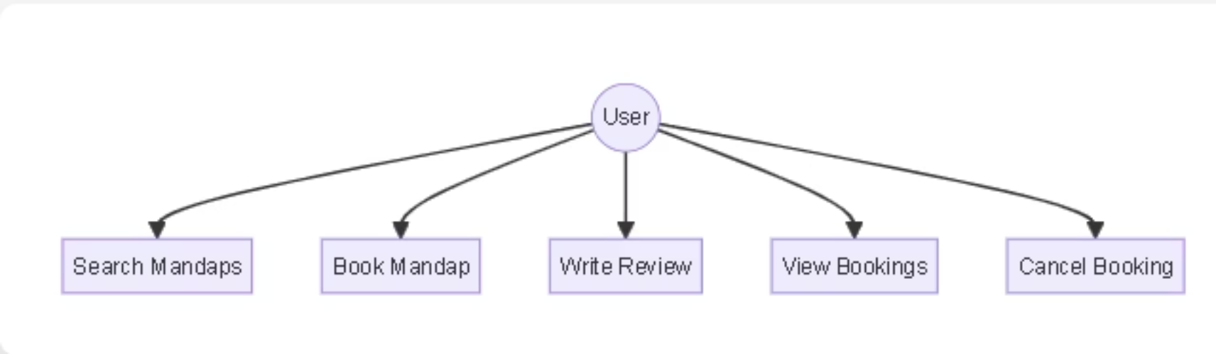
User's Use Case Diagram

Slide 8
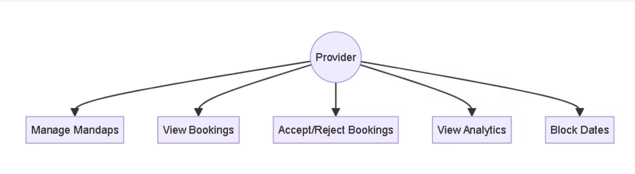
Provider's Use Case Diagram

Slide 9
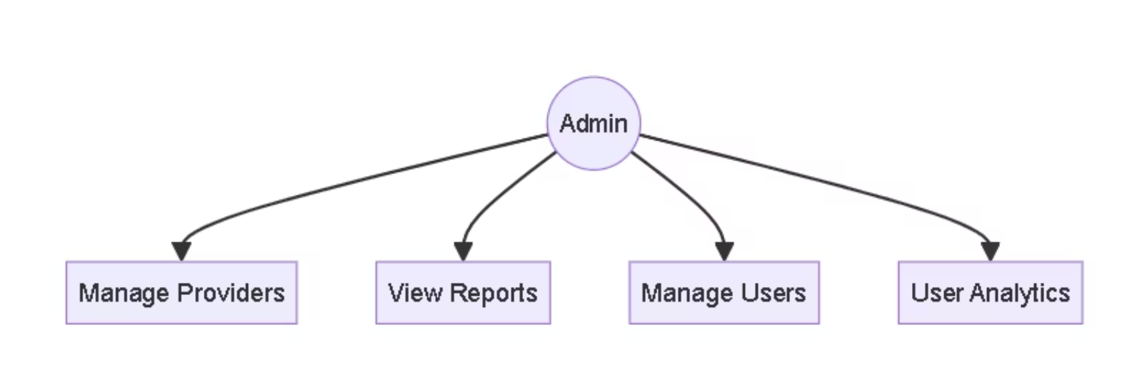
Admin's Use Case Diagram

Slide 10

PROVIDER'S PERSPECTIVE

Slide 11
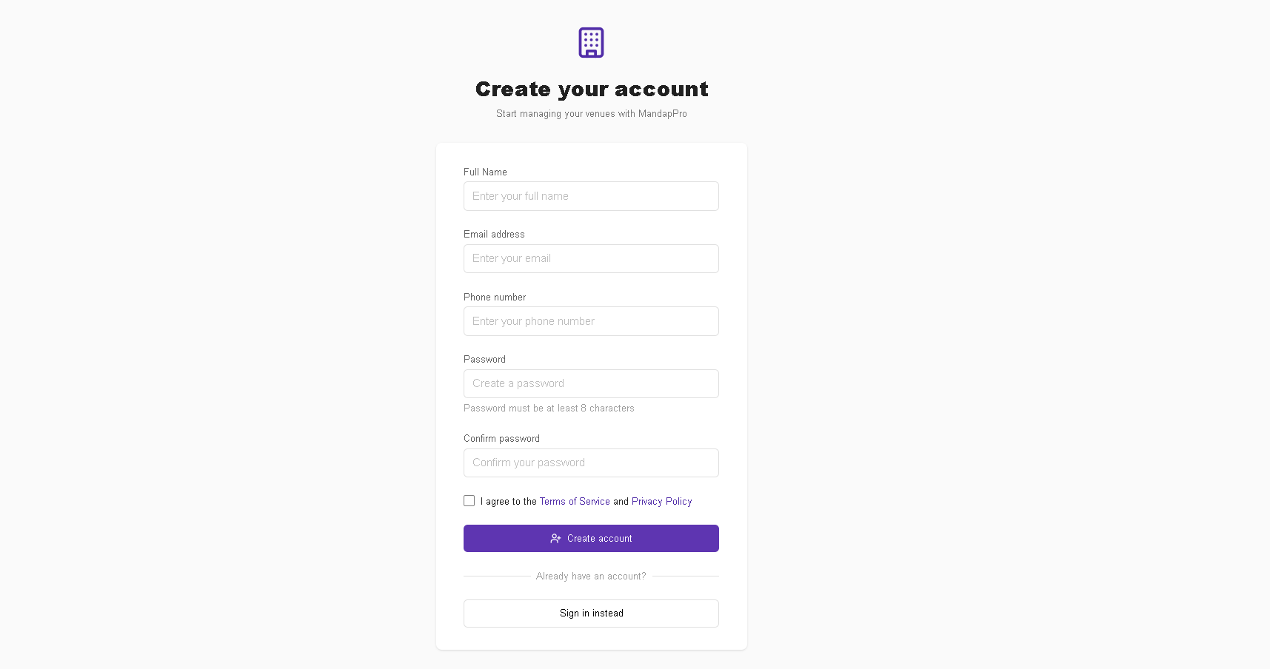
Provider Registration Page

Slide 12
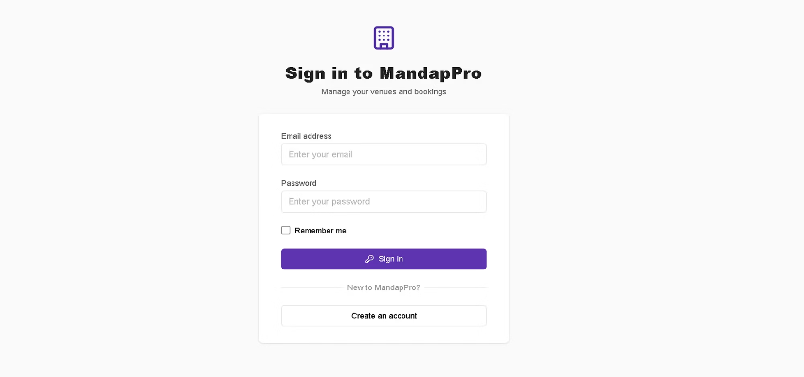
Provider Login Page

Slide 13
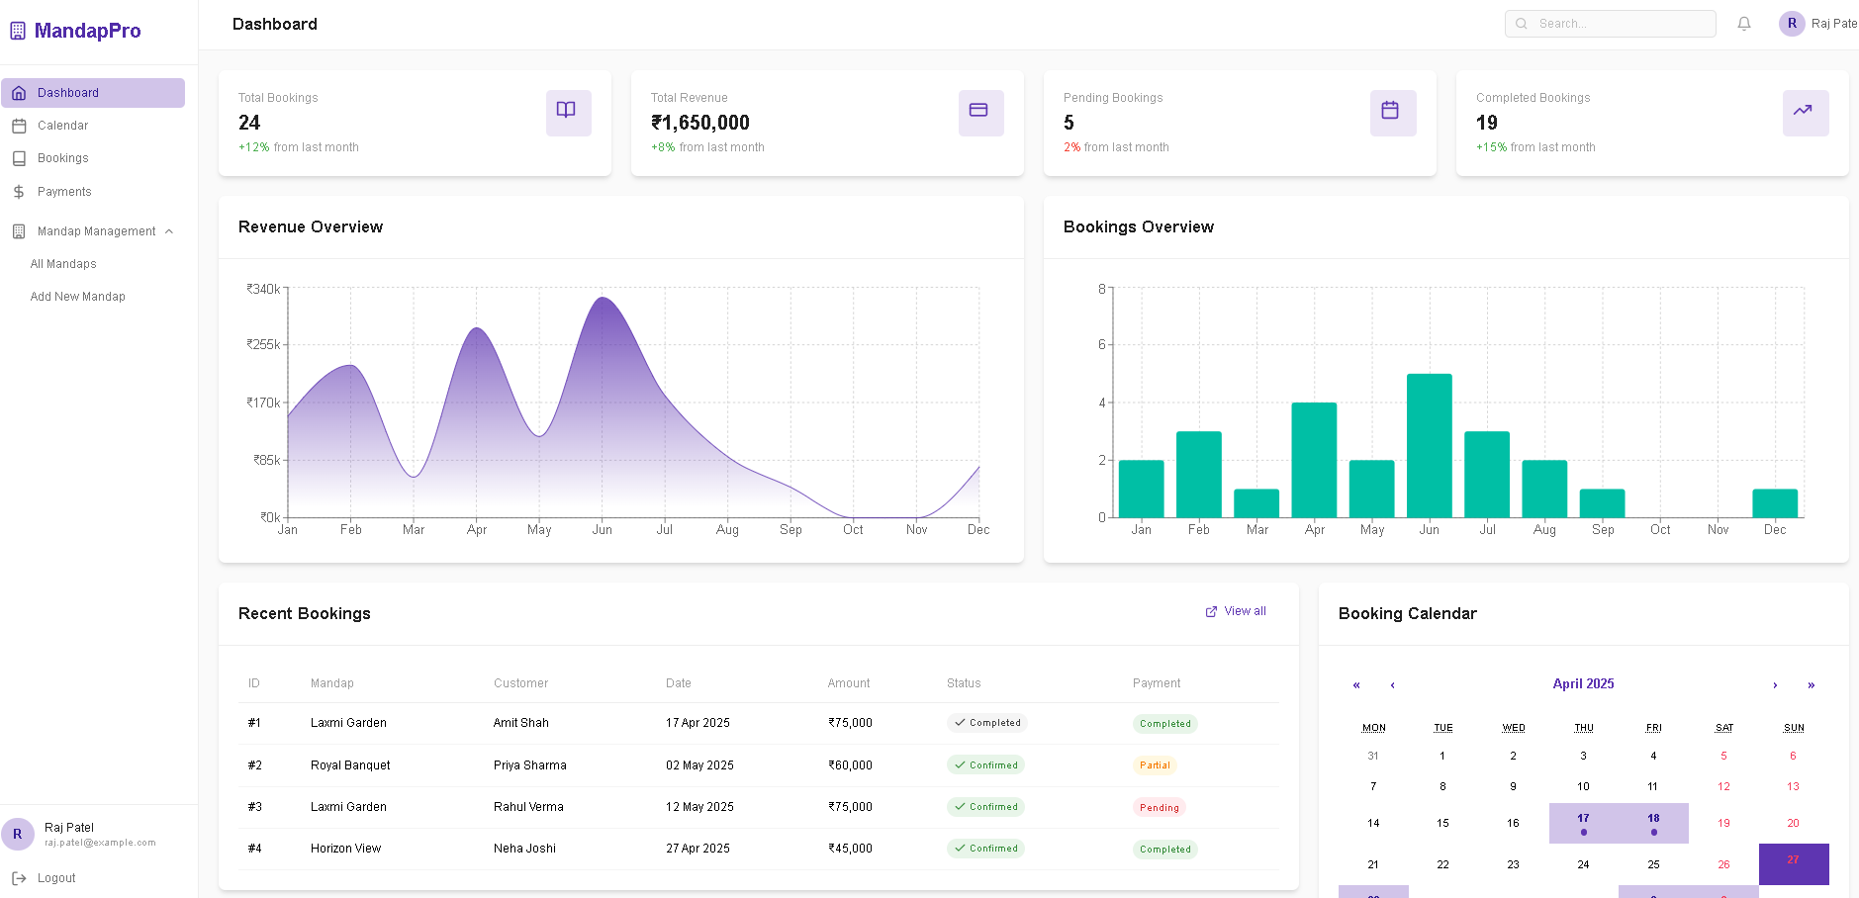
Provider Dashboard

Slide 14
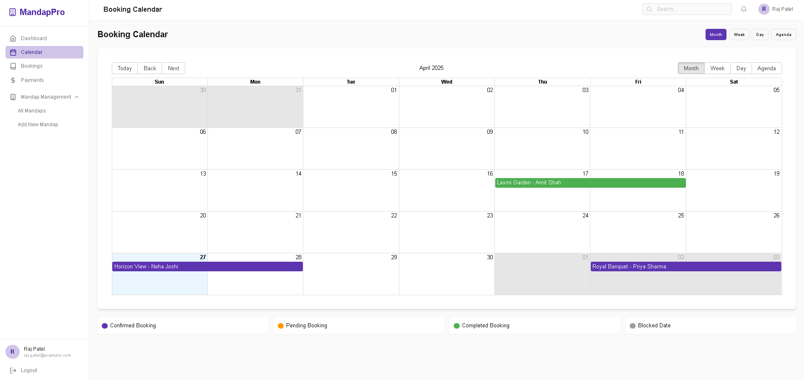
Booking Calendar

Slide 15
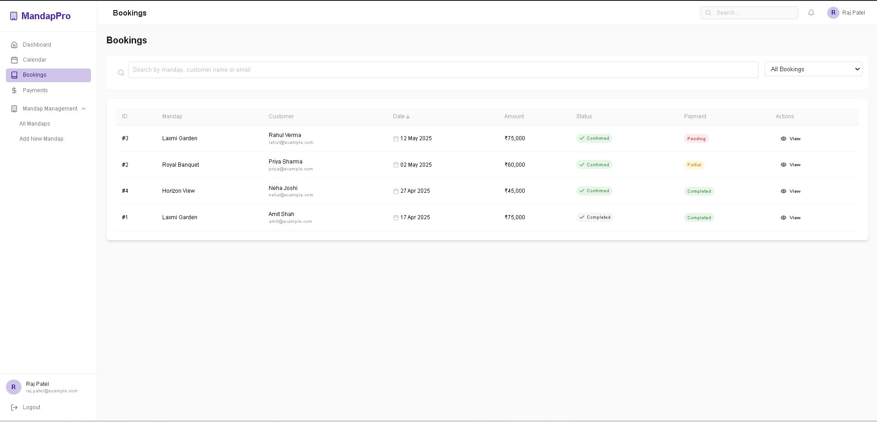
Provider's Bookings

Slide 16
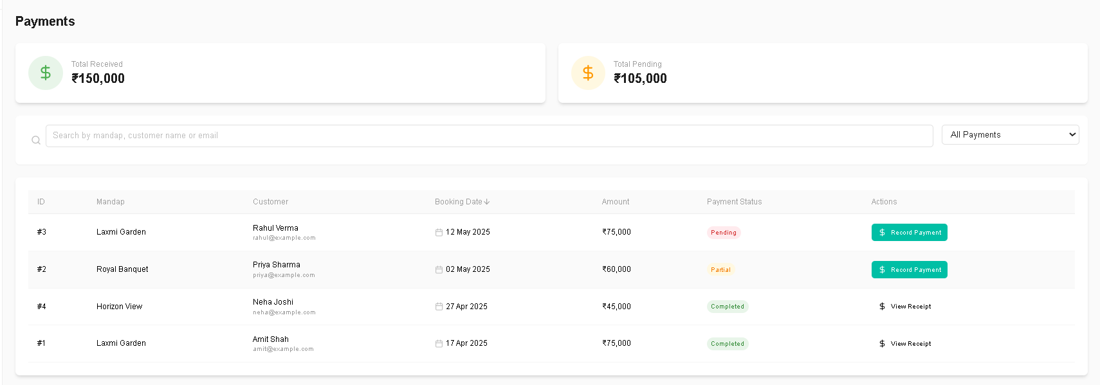
Payment History

Slide 17
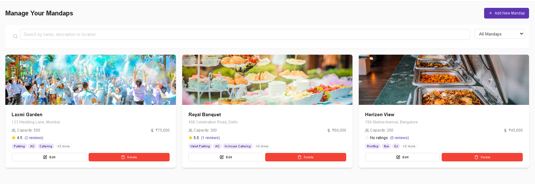
Manage Your Mandap

Slide 18
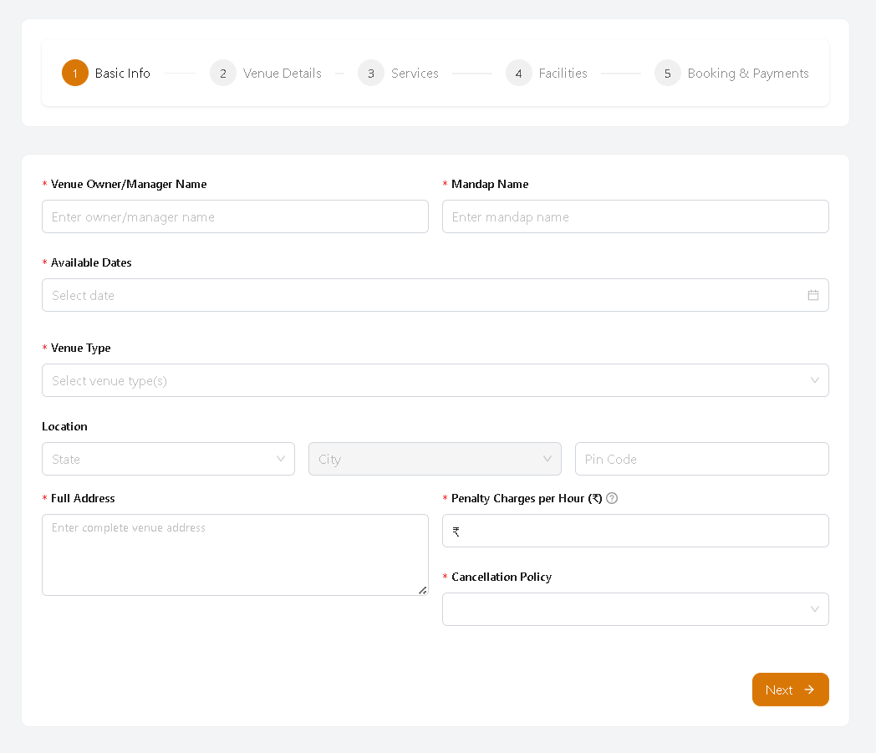
Add New Mandap

Slide 19
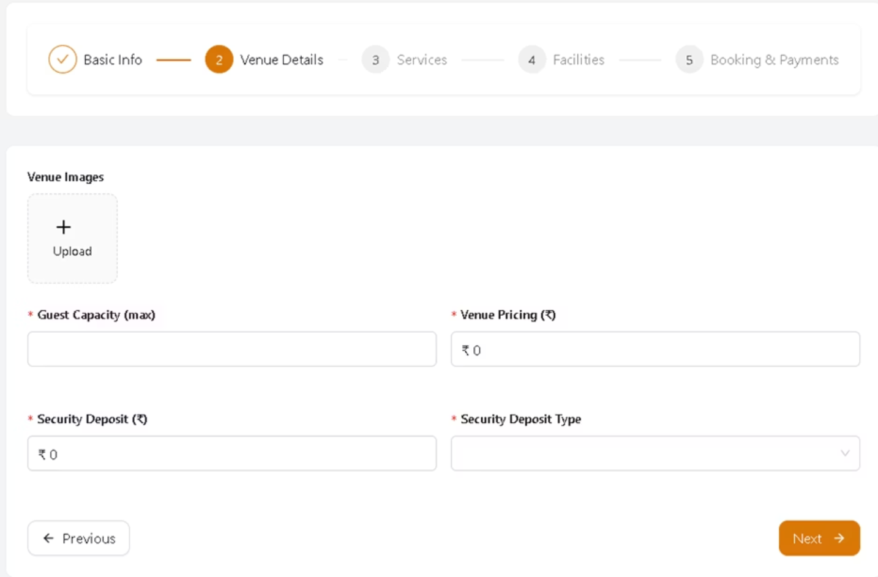

Slide 20
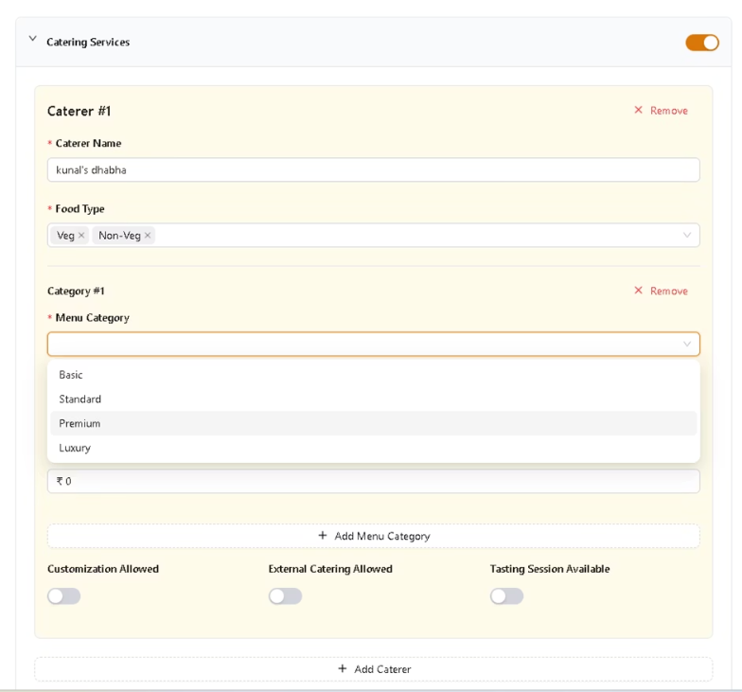
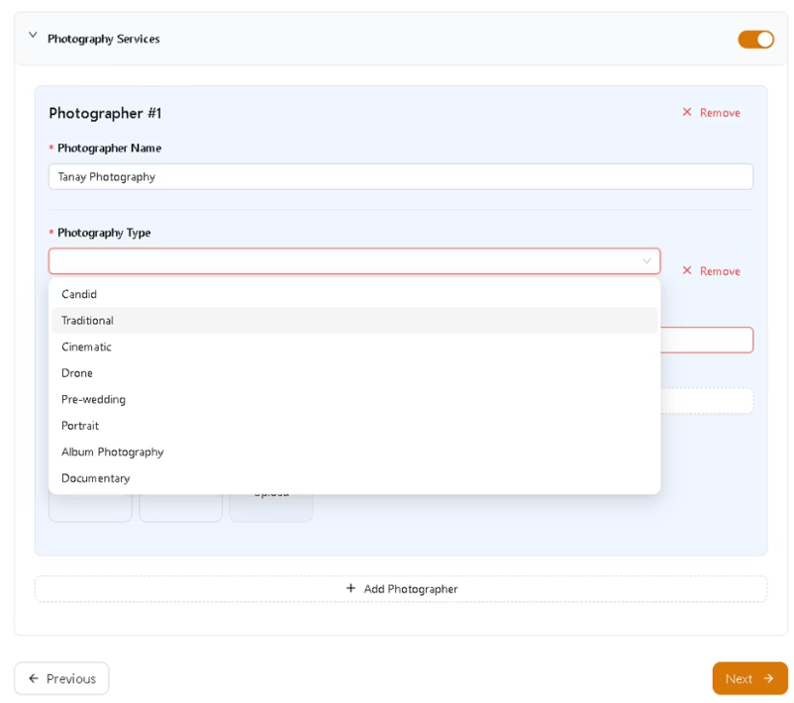

Slide 21
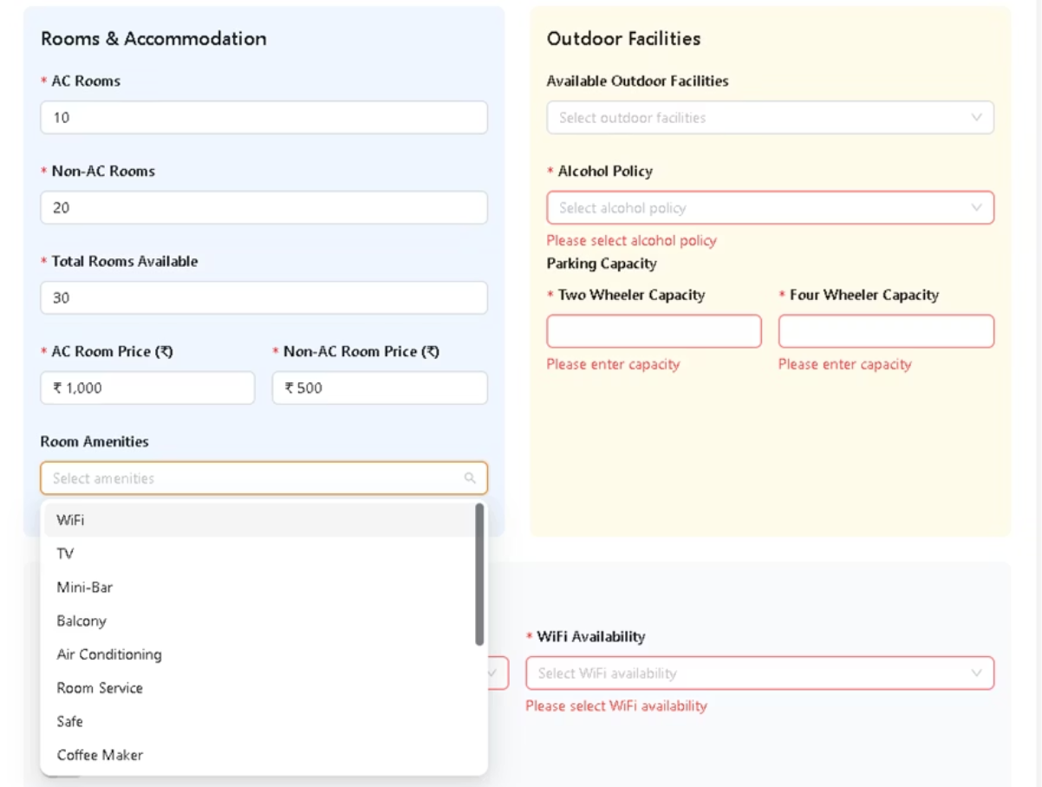

Slide 22
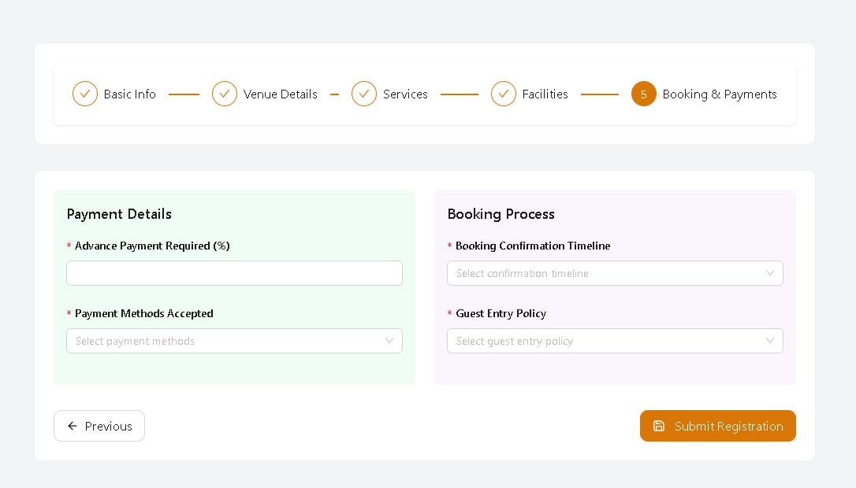

Slide 23
ADMIN PERSPECTIVE

Slide 24
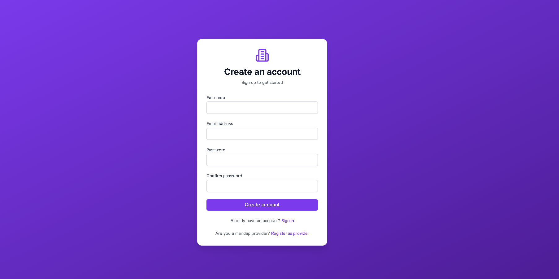
Admin Registration

Slide 25
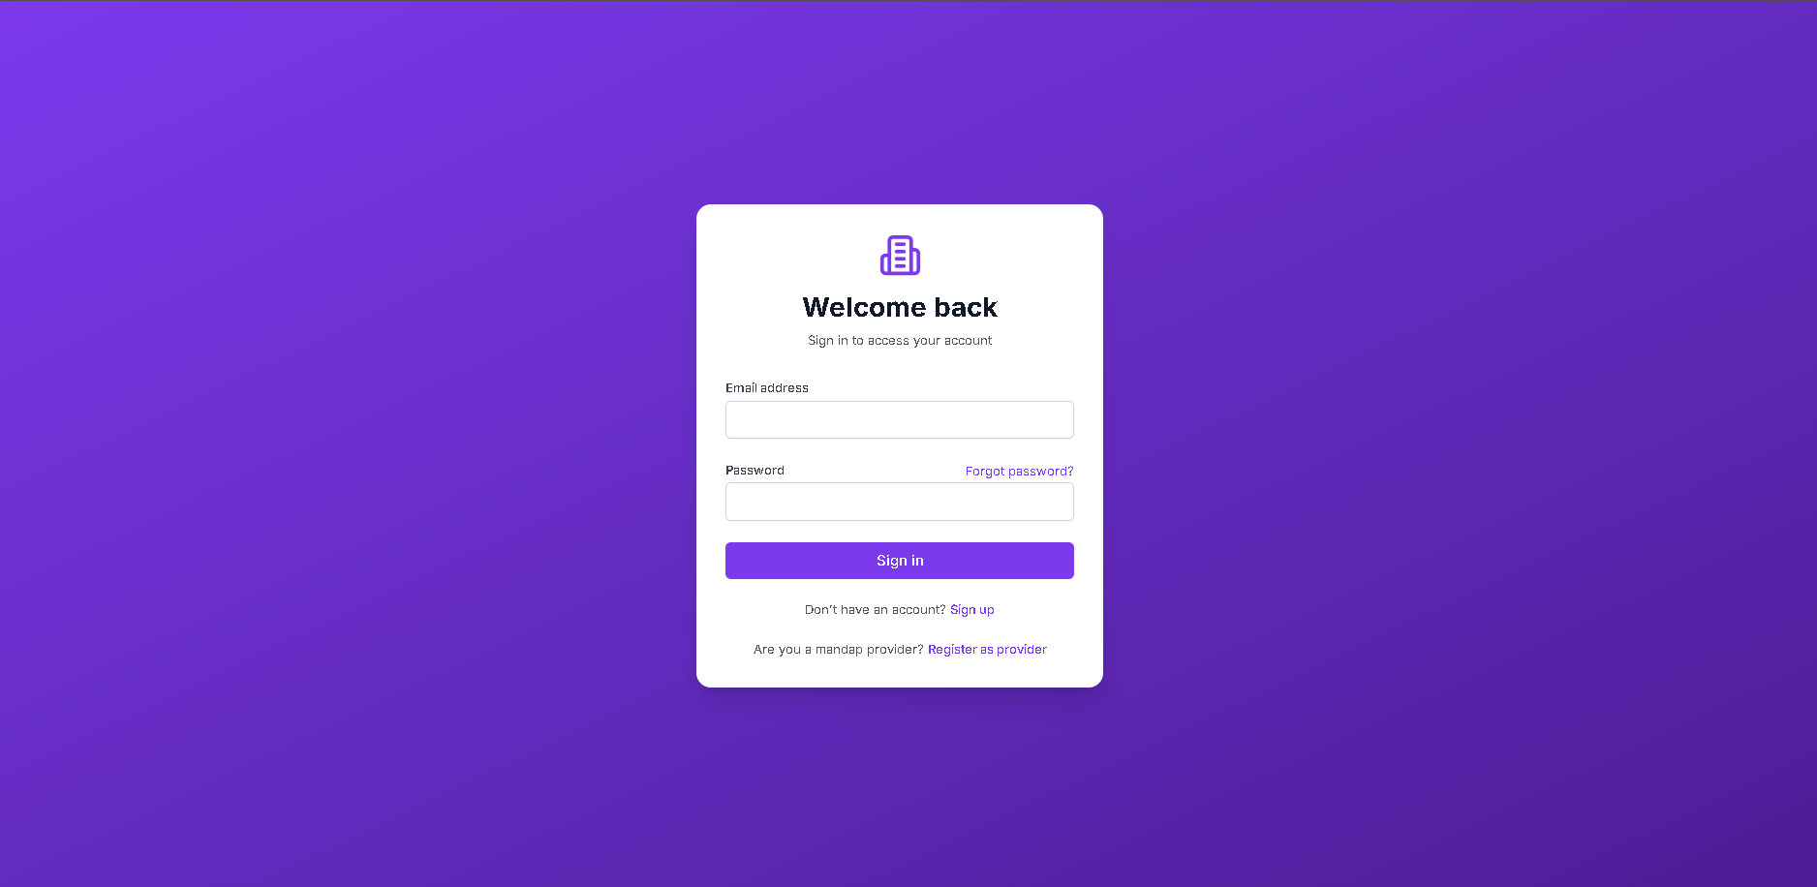
Admin Login

Slide 26
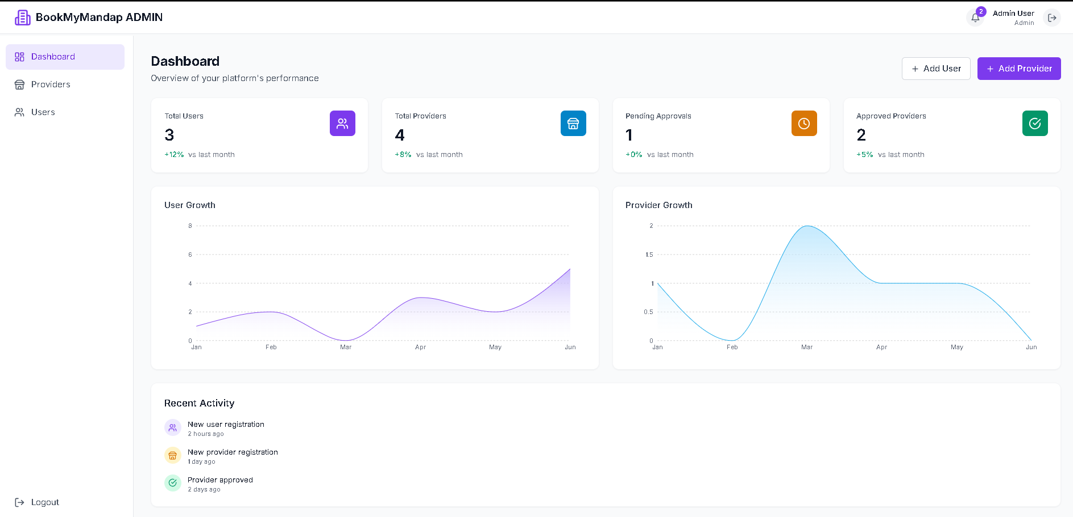
Admin Dashboard

Slide 27
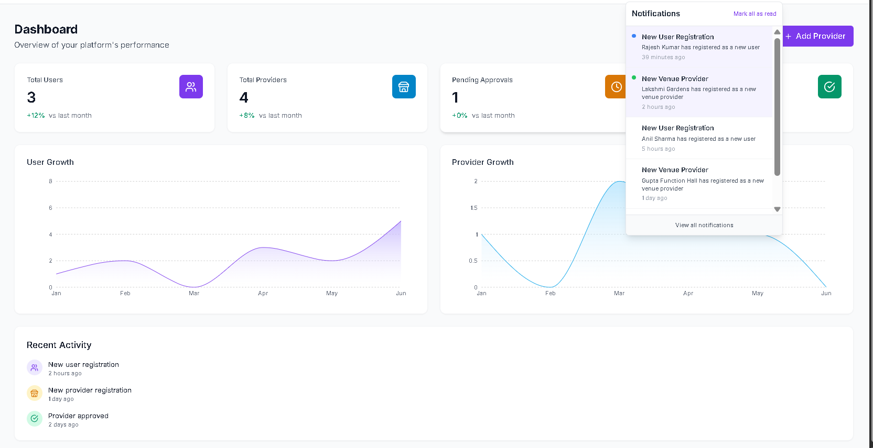

Slide 28
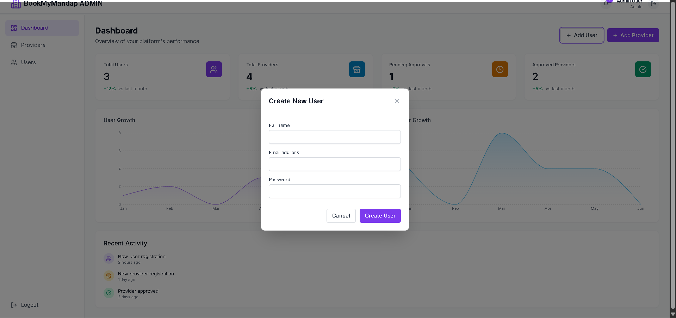
Add User

Slide 29
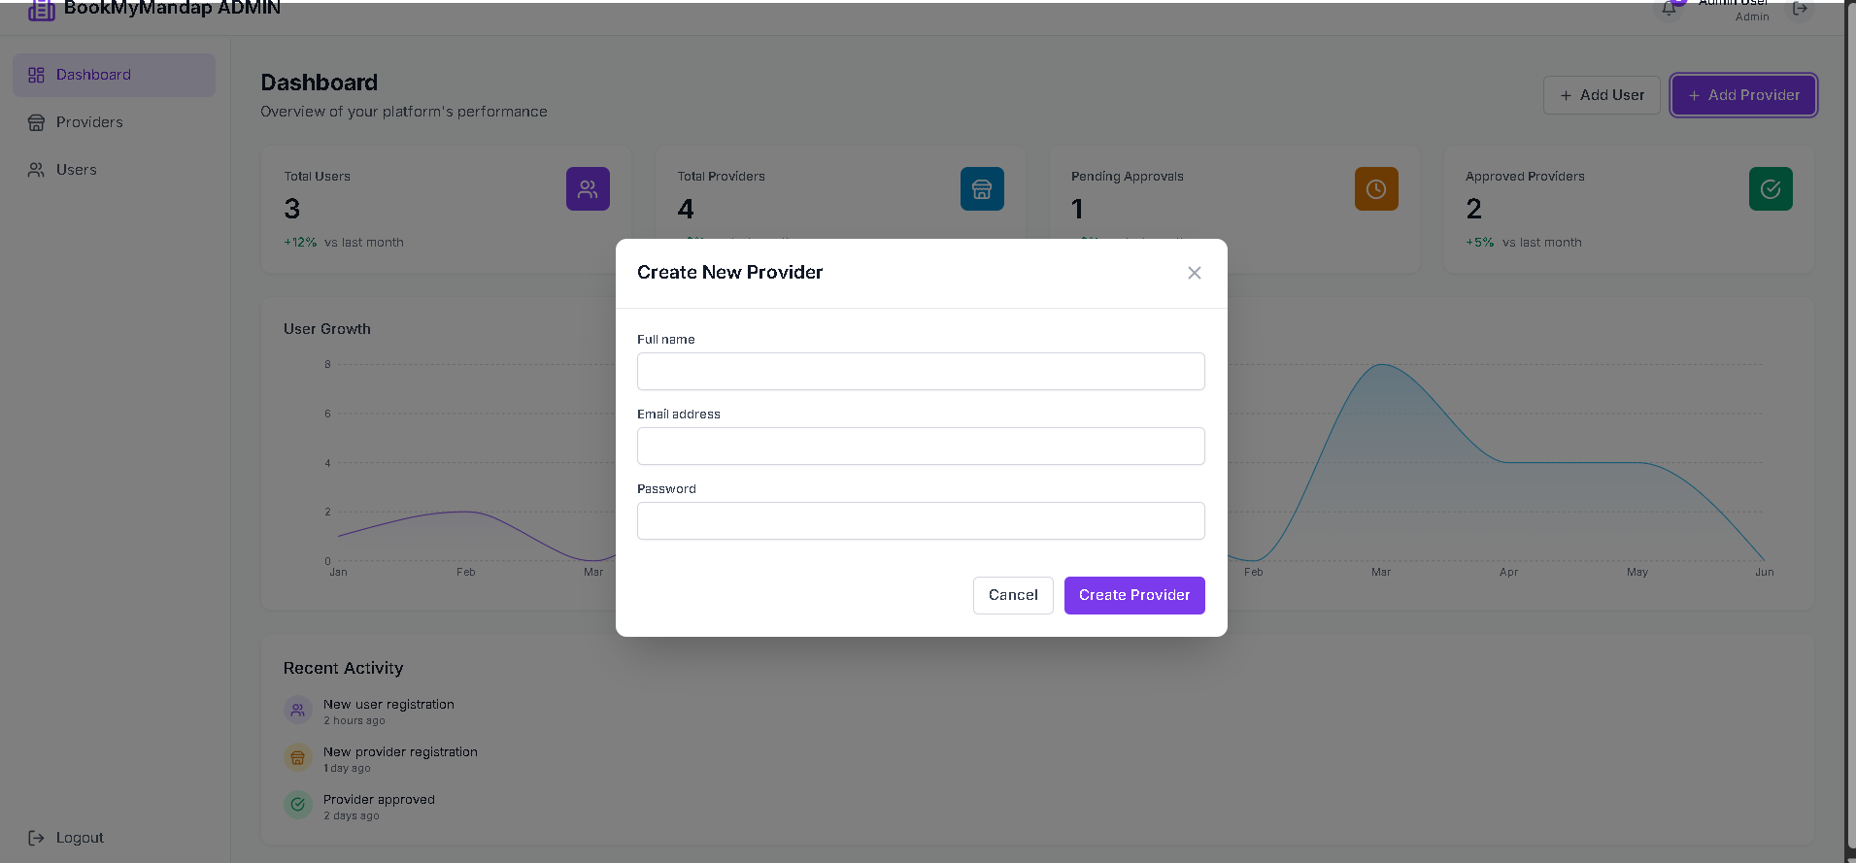
Add Provider

Slide 30
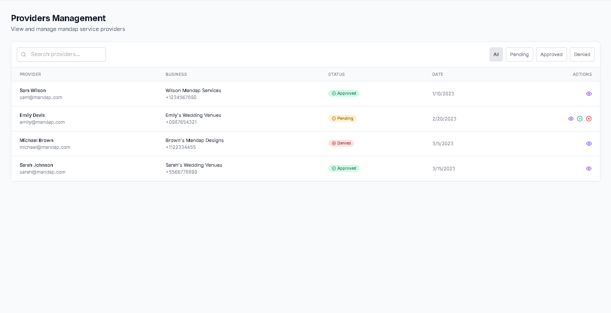
Manage provider

Slide 31
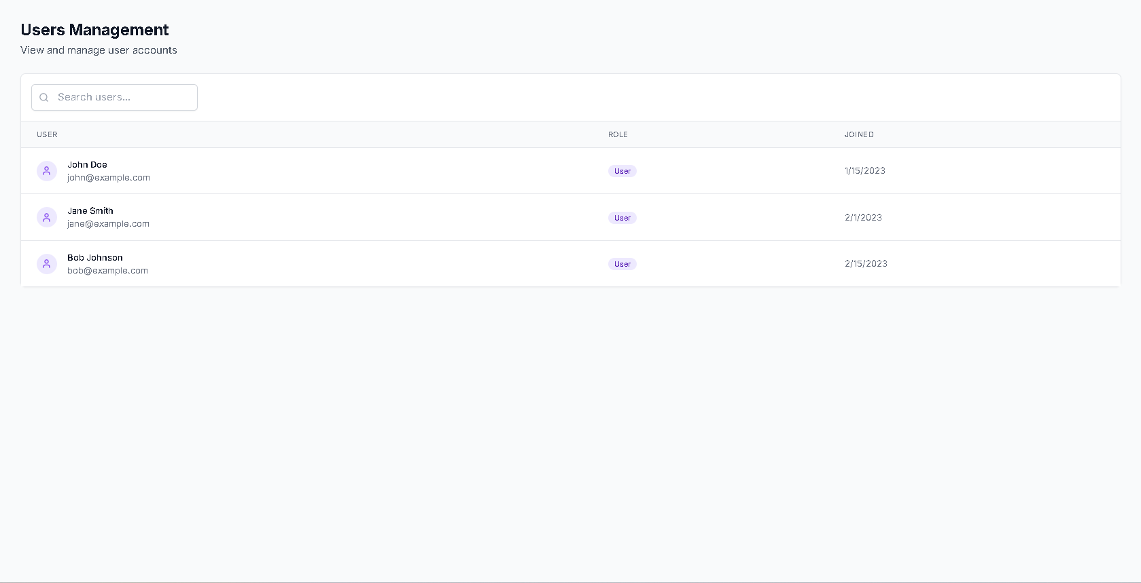
Manage User

Slide 32

BookMyMandap: Let's Create Unforgettable Events Together
Join thousands who trust BookMyMandap for effortless venue booking. Experience the future of event planning with convenience and confidence at your fingertips. Contact us today to learn how we can help make your special day truly unforgettable.

